Slide 1
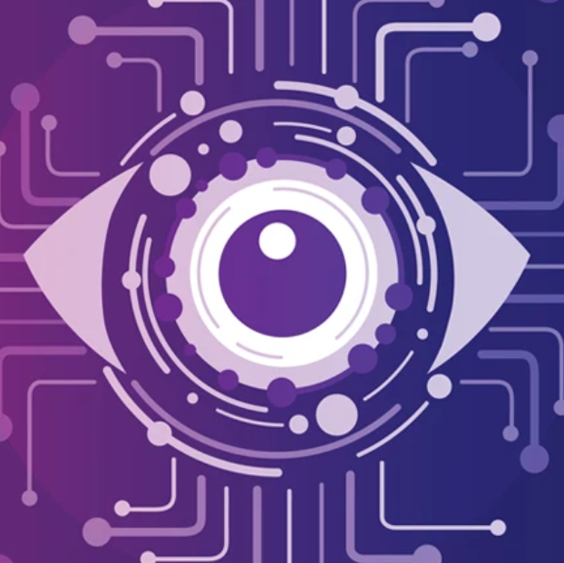
Introduction to Computer Vision
Author: Anh Hoang

Slide 2
Overview
Brief introduce an advanced technology in the IT industry: Computer Vision

Slide 3

Vision in Marvel?

Slide 4
Agenda
What is computer vision?
How does computer vision work?
Applications of computer vision
Examples of computer vision in action
The future of computer vision

Slide 5
Definition of Computer Vision
Computer vision is a field of computer science that deals with the ability of computers to understand and interpret images and videos. It is a subset of artificial intelligence (AI) that enables computers to see and understand the world around them in a similar way to humans.

Slide 6
How does computer vision work?
Computer vision systems typically work by first extracting features from images or videos. These features can be simple things like the color, brightness, and texture of pixels, or more complex things like the shape of objects or the way they move. The system then uses these features to identify objects, classify them, and track their movement over time.

Slide 7
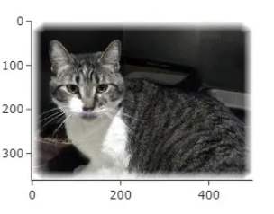
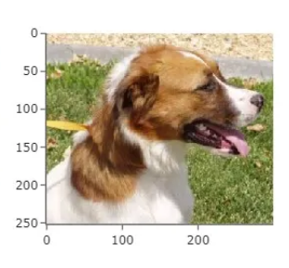
Features are keys to classify objects
#

Slide 8
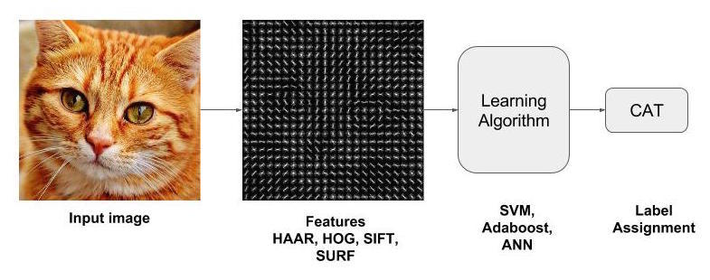
How does a machine know the picture is a cat?

Slide 9
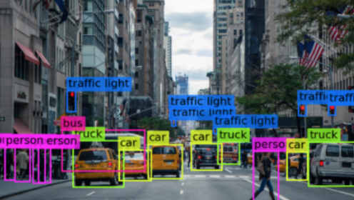

Applications of Computer Vision
Self-driving cars: Computer vision is used to help self-driving cars identify and avoid obstacles, such as other vehicles, pedestrians, and traffic signs.
Medical imaging: Computer vision is used to analyze medical images, such as X-rays and MRI scans, to help doctors diagnose diseases and injuries.
Emergency Services: Detect and track fires, shark detection

Slide 10
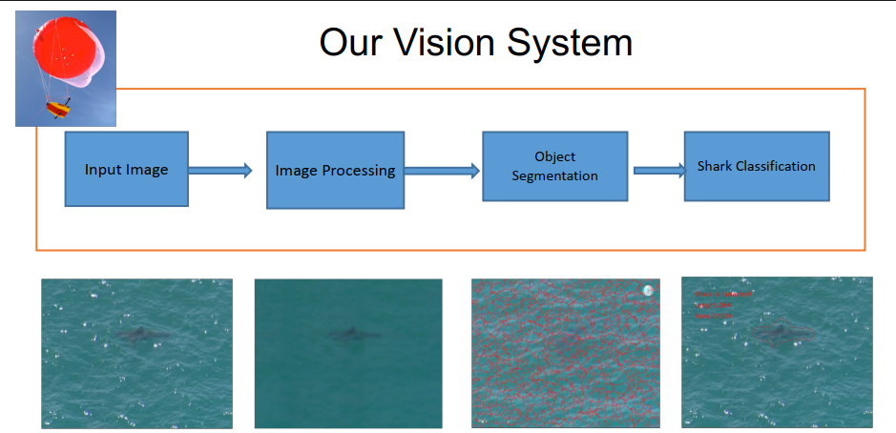
Shark Detection

Slide 11
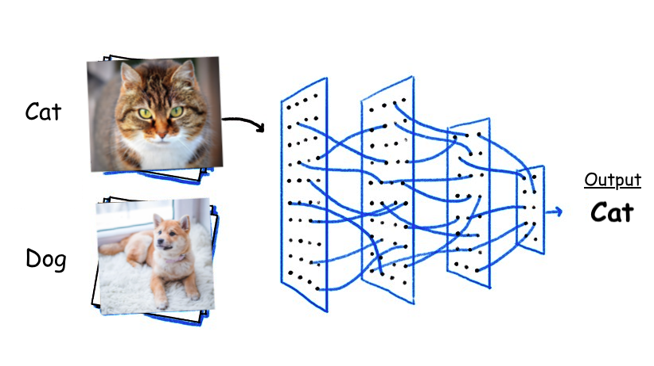
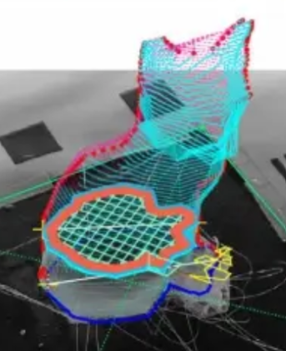
The Future of Computer Vision
Computer vision is a rapidly evolving field with new applications being developed all the time.
Deep learning: Deep learning is a type of machine learning that is very well-suited for computer vision tasks. Deep learning models have already achieved state-of-the-art results in many computer vision tasks, such as image classification and object detection.
3D computer vision: 3D computer vision is a subfield of computer vision that deals with the interpretation of 3D scenes from images and videos. 3D computer vision has the potential to revolutionize many industries, such as robotics and healthcare.

Slide 12
Conclusion
Computer vision is a powerful technology with a wide range of applications. It is still in its early stages of development, but it has the potential to revolutionize many industries and aspects of our daily lives.

Slide 13
Thank you for listening!

